Slide 1
RESEARCH PROPOSAL

Slide 2
WRITING A RESEARCH PROPOSAL
A research proposal is similar in a number of ways to a project proposal; however, a research proposal addresses a particular project : academic or scientific research.
Research proposals contain extensive literature reviews and must offer
convincing support of need for the research study being proposed.

Slide 3
ELEMENTS OF RESEARCH PROPOSAL
title
abstract
study problem
research question
rationale/ relevance of the project
specific study objectives
research methods
study design
Sample
Data collection
Statistical consideration
ethical consideration
consent form
Privacy of information

Slide 4
ELEMENTS OF RESEARCH PROPOSAL
Introduction
Problem Statement
Background
Needs statement
Objective
Proposed Technical Approach
Requirements
Architecture Design
Implementation Design
Quality Assurance Plan
Expected Project Results
Measures of Success
Schedule

Slide 5
1. TITLE
Precise
Informative
Succinct
Interesting
Improving Semantic Concept Detection through the Dictionary of Visually-
distinct Elements
Human Action Recognition across Datasets by Foreground-weighted Histogram Decomposition
ICT-supported pedagogical policies and practices in South Africa and Chile: emerging economies and realities

Slide 6
ABSTRACT
It’s a brief summarizing statement, usually 75-150 words long
An abstract includes these elements:
problem
method
result
conclusion

Slide 7
There are two kinds of abstracts:
Descriptive
Its written before the project is completed. Emphasis is on the problem and the method.
Informative
Written after the project has been completed Care is given to the results and conclusions

Slide 8
A SAMPLE: DESCRIPTIVE
The pressure distribution in the model vacuum system consisting of several volumes, pumps and gas sources was calculated using the analytical solutions of corresponding differential equations. The results were incorporated into the recently developed algorithm for similar calculations developed in FLNR~JINR Dubna, to enhance its precision. A modified code was then used to calculate the pressure distribution over the linear ion accelerator of FEI~STU. Several possibilities how to improve the vacuum conditions in the accelerator system are proposed.

Slide 9
A SAMPLE: INFORMATIVE
Subjects’ car clocks were set ten minutes fast in order to determine if deliberately setting a clock ahead will reduce lateness. One group of subjects knew their clocks had been set ahead, while a second group of subjects was not informed of the change. Over a four-week period, the subjects who were aware of the clock change regularly arrived on time or late for their scheduled appointments. Over the same period of time, the subjects who were unaware of the clock change tended to arrive early or on time for their appointments. Data suggest that intentionally setting a clock to run fast does not reduce lateness because one accounts for that extra time in his or her schedule.

Slide 10
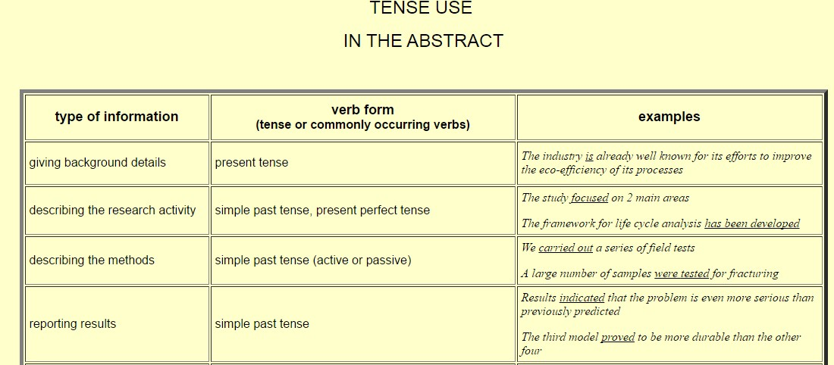

Slide 11
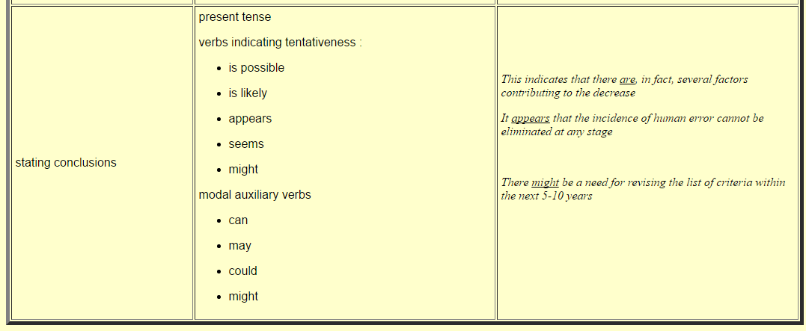

Slide 12
S T U D Y P R O B L E M
Health care issue that is a concern or a problem
Implementation of computer technology in an institute

Slide 13
H YP O T H E S IS / R E S E A R C H Q U E S T IO N
Research question.
A research question is the question that the research project sets out to answer.
In actual fact, a research study may set out to answer several questions.
The methodology used for that study, and the tools used to conduct the research, all depend upon the research questions being asked.

Slide 14
For example, in the example of a qualitative research study, the following two research questions that underpin the study, and also needed to be answered by the study, are shown in the box below.
There are two research questions that will need to be answered by this phase of the research.
These are:
'Are the perceived needs of the patients and users of South Bedfordshire's palliative care services being met?'
'If not, what needs to be done if these needs are to be met in the future?‘
The first question can be answered by a quantitative study, whereas the second one may
require a qualitative study to answer it.
Research questions can therefore be used in quantitative and qualitative research studies.

Slide 15
H Y P O T H E S IS (P L U R A L = H Y P O T H E S E S)
A hypothesis is not a question, but rather it is a statement about the relationship between
two or more variables.
So, for example, the first question could become a hypothesis by making this a statement rather than a question, namely:
The perceived needs of the patient and users of South Bedfordshire's palliative care
services are being met.
A hypothesis must include 3 components: The variables
The population
The relationship between the variables

Slide 16
R E S E A R C H P U R P O S E
A Statement of Purpose is a sentence that you write, which states, in some detail, what you want to learn about in your research project. The statement guides you as you work so that you will read and take notes only on what's needed for your project. Broad statement indicating the goals of the project.
Different types of purposes may include:
Exploration
Description
Explanation
Prediction/ control

Slide 17
To write the sentence, first answer these questions for yourself as best as you can:
What is my real personal interest in the topic? (There will always be something that can interest you)
What do I specifically want to learn about my topic?
(Don't overwhelm yourself with too many things. Two or three are plenty.)

Slide 18
For example: One person was very concerned about air pollution and wanted to know if the government is doing anything to stop it.
Her Statement of Purpose was this: I want to learn about what is being done by our
government to stop air pollution.
This Statement of Purpose will lead her to eventually write a Thesis Statement in which she will be able to make an assertion (a statement she can defend) and support it with the evidence she has gathered in her research.
Her Thesis Statement may sound something like this:
"In the United States, government regulation plays an important role in the fight against air pollution." Or, conversely, "United States government regulation has little effect in the fight against air pollution."
Whichever the case, she will use the evidence she has gathered in her research to prove her
Thesis Statement.

Slide 19
Make sure your Statement of Purpose is specific enough.
 | A Bit Too General | Much Better, More Specific
"I want to learn about the Dalai Lama."
 |  | "I want to know what role the Dalai Lama plays as the spiritual leader of the Tibetan people."
"I want to learn about AIDS." | "I want to know how close we are to a cure for AIDS."
"I want to know about pro basketball." | "I want to know what it takes to be a professional basketball player."
"I want to find out about the Marshall Plan" | "I want to know if the Marshall Plan still has any effect on the world's economy."

Slide 20
T H E S IS S T A T E M E N T
A thesis statement is a strong statement that you can prove with evidence. It is not a simple statement of fact. A thesis statement should be the product of your own critical thinking after you have done some research. Your thesis statement will be the main idea of your entire project. It can also be thought of as the angle or point of view from which you present your material.
How to write it?
Look again at your Statement of Purpose
Look at the kinds of information you have been finding while taking notes.
Decide what kind of statement you have enough evidence to prove.
(Be sure that you have done enough research to make a strong argument. You may be challenged.)
Write that as your thesis statement.

Slide 21
Statement of Purpose | Possible thesis statement
want to know how close we are to a cure for AIDS." | Although much research has gone into finding a cure for the AIDS virus, we are no closer to a real cure than we were when the disease first became known. Or After years of research , scientists are on the verge of discovering a cure for the AIDS virus.
"I want to know why Christians and Muslims fought so hard with each other during the middle ages." | Even though Christians and Muslims were supposedly fighting for religious dominance in the medieval world, their motives were strongly affected by the desire for land and economic power. Or Medieval Christians and Muslims were fighting exclusively for deeply held religious beliefs.

Slide 22
Sample purpose and thesis statements
The following example combines a purpose statement and a thesis statement (bold).
The goal of this paper is to examine the effects of Chile's agrarian reform on the lives of rural peasants. The nature of the topic dictates the use of both a chronological and a comparative analysis of peasant lives at various points during the reform period. . . The Chilean reform example provides evidence that land distribution is an essential component of both the improvement of peasant conditions and the development of a democratic society. More extensive and enduring reforms would likely have allowed Chile the opportunity to further expand these horizons.

Slide 23
Examples of Ineffective Purpose Statements:
"The purpose of this paper is to describe the changes that are occurring in corporate America."
Critique: too vague and broad. No clear expectation of what the reader will learn. Questions: What specific changes in corporate America will be described? What types of changes? What aspects of corporate America will be discussed? Will this paper also discuss the effects of these changes?
"The purpose of this report is to discuss the eating disorders Anorexia and Bulimia."
Critique: too vague and broad. It is not clear what aspect of these disorders will be discussed, or what the reader will learn. Questions: What specific aspects of these eating disorders will be discussed? The causes of these disorders? The signs or symptoms of these disorders? The effects of these disorders? If so, what types of effects - physical, emotional, psychological?
"This article will cover the different ways a company can become organized."
Critique: obscure and misleading. It is not clear what is meant by "different ways" or "become organized." These terms are vaguely stated and ambiguous. Questions: What is meant by "different ways" and "become organized"? What, specifically, will the reader learn about companies and how they become organized? Any specific types of organization? Any specific types of companies?

Slide 24
Examples of effective purpose statements:
"This paper will describe four common causes of co-worker conflict in organizations and
explain how to use a five-step procedure to constructively manage this conflict."
Critique: Very specific about what aspects of conflict will be discussed. Very precise about how much information will be given. Very clear about what the reader will learn.
"This report will explain how supervisors can use four planning strategies to improve employee productivity in the workplace."
Critique: Very specific about what will be discussed (planning strategies), and what the outcome
will be for the reader (how to improve employee productivity).
"The purpose of this report is to describe the main causes of traffic congestion in Seattle."
Critique: Leaves no doubt about the report's main purpose. Specific about the focus of the traffic
congestion (Seattle).

Slide 25
1. How can heat loss be prevented in a two-storey brick house?
Exercise: For the following research problems, try to generate specific purpose statements.
How are writing skills taught in the secondary section of government schools?
why did the coliseum roof collapse?
How can the overeating of non vegetarian food affect a person’s spirituality?
What are the factors behind the increasing criminal activities in Karachi?

Slide 26
S T U D Y R A T IO N A L E
In this section, you are arguing why your study should be done. Be sure to explain how you study fits into those areas.
Ask yourself:
Will this study generate new knowledge?
Will the study benefit society, advance understanding or influence policy?
Will the study fill gaps in existing knowledge or resolve current controversies?
Generally a study should do more than just generate new knowledge. The knowledge should in some way be useful, either by leading to a tangible benefit such as improved patient care, or a less tangible one such as addressing an area of controversy

Slide 27
7. RESEARCH METHODS
study design
Sample
Data collection
Statistical consideration

Slide 28
8. ETHICAL CONSIDERATION
consent form
Privacy of information

Slide 29
IMPORTANT SITES
http://www.phrasebank.manchester.ac.uk/
http://www.digitallibrary.edu.pk/
https://sites.google.com/a/nu.edu.pk/national-university-of- computer-emerging-sciences-fast-library/
http://digitallibrary.edu.pk/natunicomp_emrgsc.html

Slide 30
RESEARCH PROJECT PROPOSAL FORM
Group Members:
Venue:
Research Problem: Derive a problem from a paper from the Journal of Computer Assisted Learning
Research Question/ Hypothesis: Purpose:
Relevance and Benefits of the study:
Literature Review:
Research Methodology:

Slide 31
PROJECT MILESTONES
Proposal Submission: 5th April
Literature Review Submission: 12th April
Introduction and Questionnaire: 29th April
Result: 3rd May
Conclusion: 10th May
Project Submission and Presentation: 24th-28th May
Find a problem from the journal of Computer Assisted Learning:
https://onlinelibrary.wiley.com/journal/13652729

